Slide 1
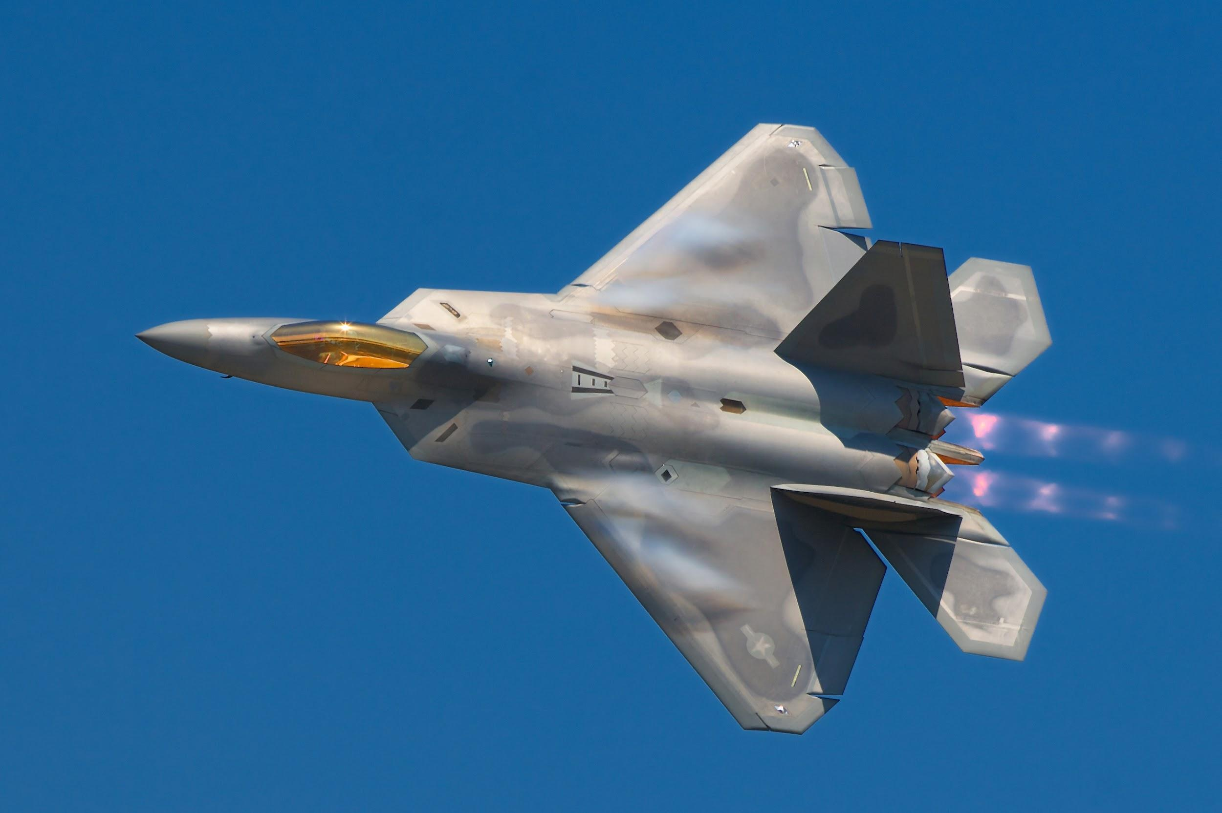
Prediction of Remaining Useful Life of an Aircraft
S Uday Bhaskar
16ME10058

Slide 2
Health Index
Indicates the probability of given state to be healthy(HI=1)
9 sensors which are showing trend are selected for building Random Forest
First 30 cycles are assumed as healthy (HI=1) while the last cycle as faulty state (HI=0)
Trained a random forest for each Operational setting with 10 decision trees
Restricted the maximum depth of a tree to be 5 to reduce overfitting
Enabled BootStrapping to deal with low amount of data per operational setting
Predicted HI of a given state is the ratio of no. of trees predicting the state to be healthy to the total no. of trees in the random forest

Slide 3
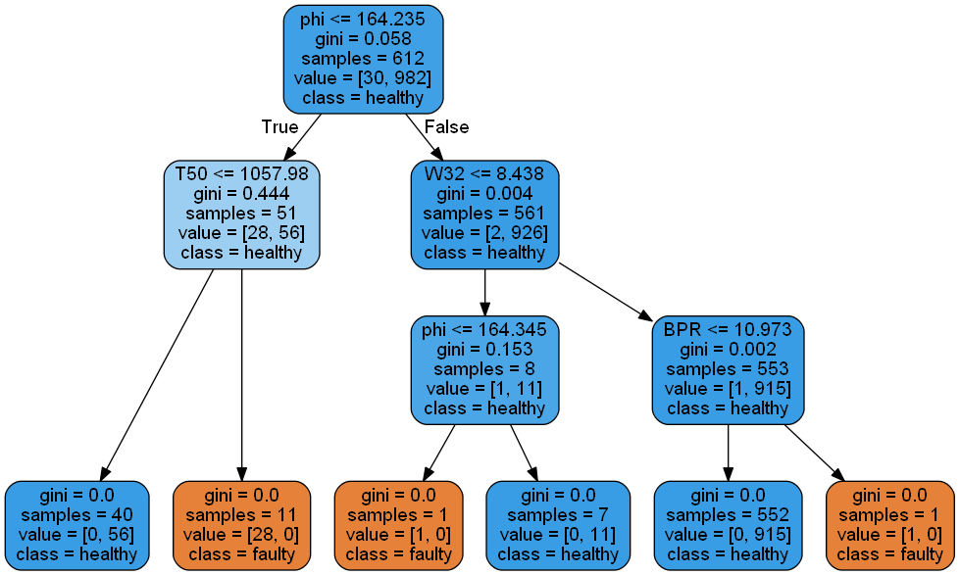
Sample of a Decision tree of a Random Forest

Slide 4
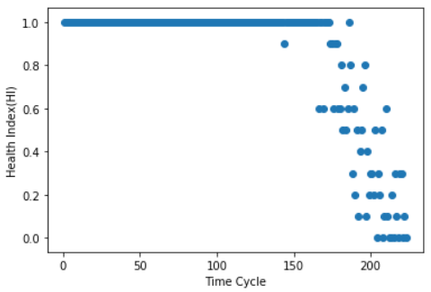
HI vs Time cycles of an aircraft

Slide 5
BiDirectional-LSTM Neural Network
Train and Test sets are normalized operational setting wise using MIN-MAX normalization
9 sensors showing trend,calculated HI,Time cycle, Operational Setting are selected as features
50 consecutive time steps are fed to training to predict the 50th time cycle’s RUL
Example:
if an aircraft in training data has 200 cycles then 1st to 50th,2nd to 51st,…….151st to 200th time cycle’s data are fed to training to predict 50th,51st,......200th time cycle’s RUL. Like this 151 samples are created from this aircraft.This is done for every aircraft in the training data to create more samples.
Tuning was done to obtain correct set of hyperparameters like no.of layers,nodes,batch size etc
Our Architecture contains 2 LSTM layers with 24,10 nodes each and a dense layer at the output
2 Dropout layers are inserted between the above layers to reduce overfitting

Slide 6
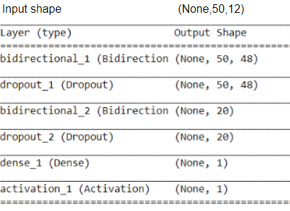
Model Architecture
Input Shape - (None,50,12) Output shape - (None,1)

Slide 7
Validation and Prediction
5% of training data is set to validation set and call backs like early stopping,model checkpoints to capture the weights having least validation loss
In the test set, last 50 cycles are considered as input for predicting the RUL of each aircraft
Example:
If an aircraft of test data has 150 cycles then 101th to 150th time cycle’s data is fed as input sample to predict the 150th time cycle’s RUL which is our result.
For aircrafts having less than 50 cycles in the test set, an RUL of 125 is assumed

Slide 8
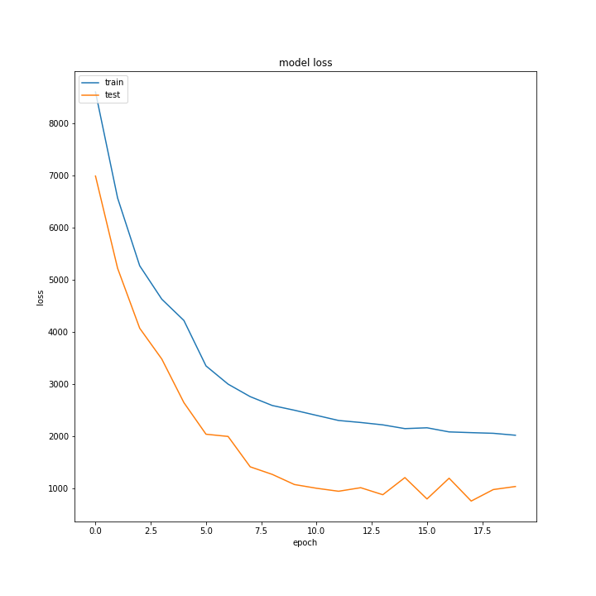
MSE vs Epochs of train & validation set

Slide 9
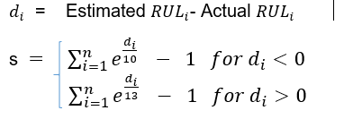
Scoring Function and Results
The Score Obtained through above mentioned approach is 1131

Slide 10

It was fun working with u sir !!

